Slide 1
EXERCISE 1
Forward “Hello World” example
Aims:
Familiarise with FLEXPART structure and output
Set-up and execute a simple scenario
Plotting the output
Effect of the OUTGRID resolution
Effect of the number of particles
Questions? Write delia.arnold-arias@zamg.ac.at
Notes:
1
1

Slide 2
Compiling FLEXPART on ZAMG’s virtual machines
#ifeq ($(gcc), 4.9)
# Compiled libraries under user ~flexpart, gfortran v4.9
# ROOT_DIR = /homevip/flexpart/
# F90 = ${ROOT_DIR}/gcc-4.9.1/bin/gfortran
# MPIF90 = ${ROOT_DIR}/bin/mpifort
# INCPATH1 = ${ROOT_DIR}/gcc-4.9.1/include
# INCPATH2 = ${ROOT_DIR}/include
# LIBPATH1 = ${ROOT_DIR}/lib
# System libraries at ZAMG, gfortran 4.9.2
F90 = gfortran
MPIF90 = mpif90
INCPATH1 = $(GRIB_API_INCDIR)
INCPATH2 = $(NETCDF_INCDIR)
LIBPATH1 = $(GRIB_API_LIBDIR)
LIBPATH2 = $(NETCDF_LIBDIR)
#else
# Compiled libraries under user ~flexpart, gfortran v5.4
# ROOT_DIR = /homevip/flexpart/
# F90 = /usr/bin/gfortran
# MPIF90 = /usr/bin/mpifort
# INCPATH1 = ${ROOT_DIR}/gcc-5.4.0/include
# INCPATH2 = /usr/include
# LIBPATH1 = ${ROOT_DIR}/gcc-5.4.0/lib
#endif
tar -xvf flexpart_v10.3.1_3cd0f17.tar
Edit makefile (see box to the left)
Compile: make serial
https://www.flexpart.eu
Edit par_mod.f90 (for ECMWF data):
integer,parameter :: nxmax=800,nymax=400,nuvzmax=138,nwzmax=138,nzmax=138, nxshift=0
integer,parameter :: maxnests=1,nxmaxn=800,nymaxn=400
integer,parameter :: maxpart=5000000
integer,parameter :: maxspec=10
LIBS = -lgrib_api_f90 -lgrib_api -lm -lnetcdff
LDFLAGS = $(FFLAGS) -L$(LIBPATH1) -Wl,-rpath,$(LIBPATH1) $(LIBS) -L$(LIBPATH2)
LDDEBUG = $(DBGFLAGS) -L$(LIBPATH1) $(LIBS) -L$(LIBPATH2)

Slide 3
Some preparations… Preparing the structure
mkdir exercises → make the exercises folder
cd exercises → enter the exercises folder
mkdir Hello_World_fwd and cd Hello_World_fwd → make the directory for your hello world forward exercise
ln -s /path/to/metdata/ECMWF_meteorological_input/ ./ or ln -s /path/to/metdata/NCEP_meteorological_input/ ./
Find the necessary meteorological input data sets in “ECMWF_meteorological_input” and “NCEP_meteorological_input” for all the hands-on which path has to be entered in the respective pathnames file later on.
Meteorological files are heavy and it is best not to copy them in multiple places, linking is ideal.

Slide 4
Some preparations… Preparing the structure
mkdir exercises → make the exercises folder
cd exercises → enter the exercises folder
mkdir Hello_World_fwd and cd Hello_World_fwd
ln -s /path/to/metdata/ECMWF_meteorological_input/ ./ or ln -s /path/to/metdata/NCEP_meteorological_input/ ./
Copy pathnames file and options folder from FLEXPART 10 folder. Pathnames file has to be edited accordingly for every exercise!
cd options Replace sub-folder SPECIES by ln -s /path/to/SPECIES/ ./
Link FLEXPART gfortran executable to working directory (i.e., Hello_World_fwd)
cp /path/to/plotting/plot_FLEX_binary.py ./
cp /path/to/plotting/read_header.py ./
cp /path/to/plotting/read_grid.py ./
9. mkdir output_[ECMWF,NCEP]
Remember steps 3 to 9 for all test cases!

Slide 5
Hello World fwd & plotting
This test case aims at making you run FLEXPART with a very simple case to warm-up for the following, more complicated FLEXPART options
Specifications:
COMMAND FILE:
Forward run: 1 March 2007 9 am UTC to 2 March 2007 14 UTC
Output every hour
Convection
Concentration output
Nested output
No adaptation to TL
OUTGRID FILE:
Resolution 0.1 degree
LLC: 37.0°N, 0.0°E
70 x 200 grid cells
1 output layer, 250 m a.g.l.
OUTGRID NEST
Resolution 0.015
420 x 220 grid cells
LLC 37.5°N°E. 1.0°E
RELEASES FILE:
Point source at the top of the INTE building: 41.384° N, 2.116° E, 60 m a.g.l.
Release start: 1 March 2007 9 UTC
Release end: 1 March 2007 21 UTC
Total mass: 21 kg of SO4 aerosol
Particles released: 10000
Does all this make sense? What does this mean? Discuss results and test different output resolutions. The sync and average times. Number of particles.
Launch FLEXPART!
Notes:
5
5

Slide 6
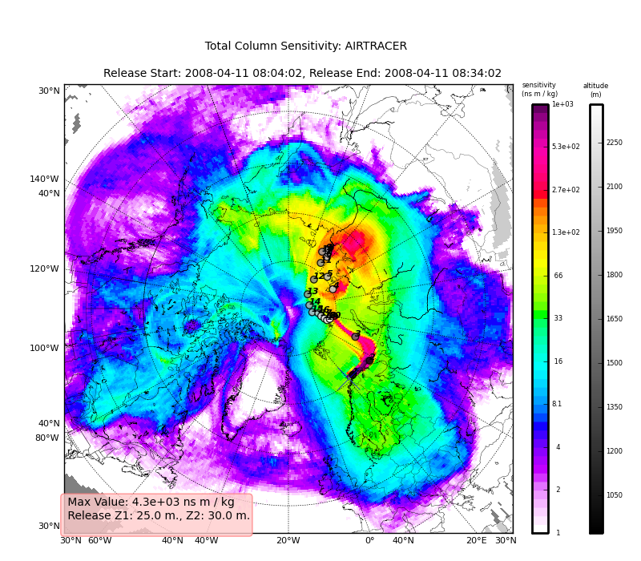
Hello World fwd & plotting
Reflexible (evolution of pflexible) John Burkhart https://github.com/spectraphilic/reflexible
+ Python based
+ handle both binary and netcdf output
+ Easy folding with gridded inventories
+ ZAMG uses a variation of it operationally
+ Additional routines for dumping information and processing files (accumulate )
+ Simple plotting and complex plotting
QuickLook
Radek Hofman https://bitbucket.org/radekhofman/quicklook/
Based on flex_81.py
Under development
+ Easy command line parameters
+ Responsive developer
+ Python based
Notes:
6
6

Slide 7
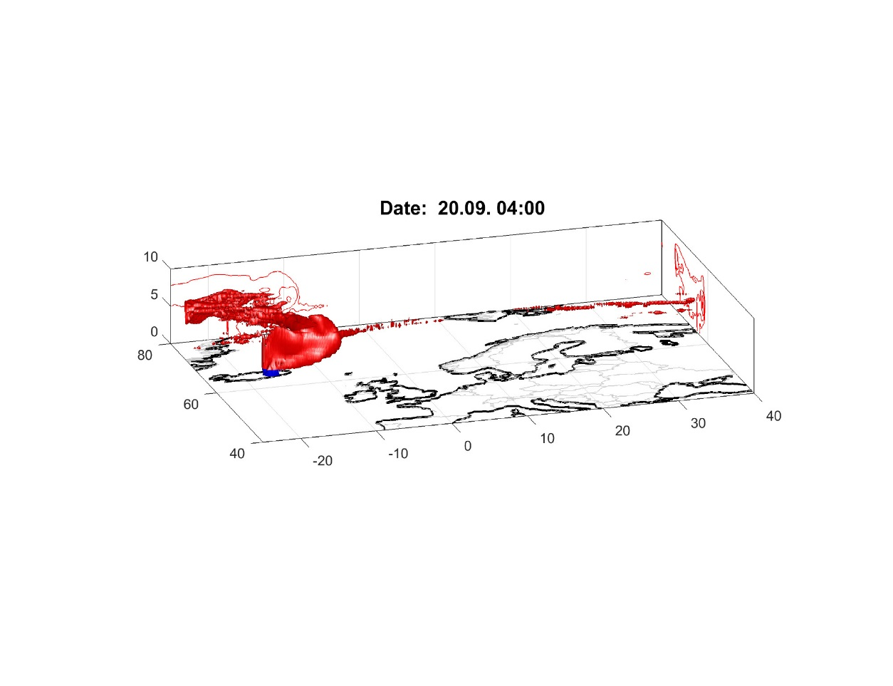
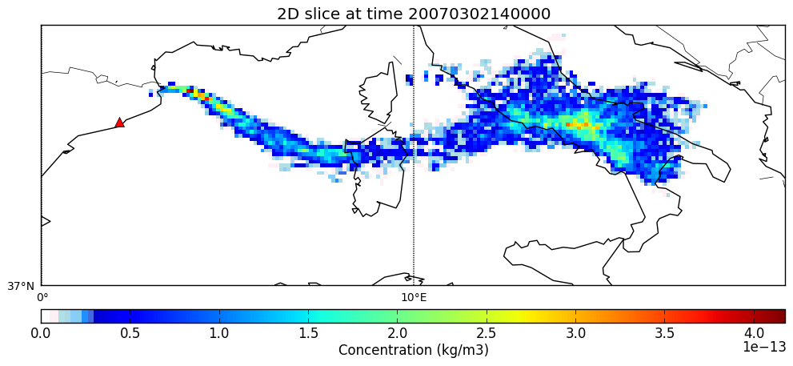
Hello World fwd & plotting
Even some options for 3D plotting
Matlab:
Requires license
Not fast
Sabine Eckhardt (NILU)
+ Easy folding with gridded inventories
+ nice 3D plotting capabilities
+ designed to deal with matrices
+ rendering possible
plot_FLEX_binary.py
Delia Arnold (ASC, ZAMG), Christian Maurer (ZAMG), Don Morton (Boreal SciCom)
+ Free
+ Simple to use
+ Python based
Very limited and developed for in-house use or testing
Notes:
7
7

Slide 8
Hello World fwd & plotting
Note there is the option of plotting the NetCDF output
https://www.giss.nasa.gov/tools/panoply/download/ PANOPLY(useful for Windows users)
http://meteora.ucsd.edu/~pierce/ncview_home_page.html NCVIEW
…
Notes:
8
8

Slide 9
ECMWF: Hello World fwd & plotting
Results:
Did you get a ‘congratulations’ message on your run?
Yes → We should see the output produced
No → Were the option files well set? Was the compilation appropriate for your run? Is recompilation (with adjustment of par_mod.f90) needed?
Species name
Release index (0: first release )
Output directory
./plot_FLEX_binary.py ./output_ECMWF/ False tracer1 0 0 alldates cyl False 0,20,37,44 mesh False
Projection : Lambert or cylindric
Level index (0: first level )
No deposition plotted
Add marked locations
False – plot the MOTHER domain
Mesh or contour plotting
Dates to plot: „alldates“ or user-defined list of dates, e.g., 20170925000000,
20170925010000
Plotting region: left and right lon, lower and upper lat
Notes:
9
9

Slide 10
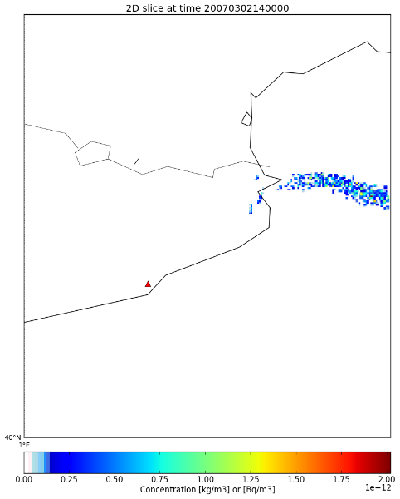
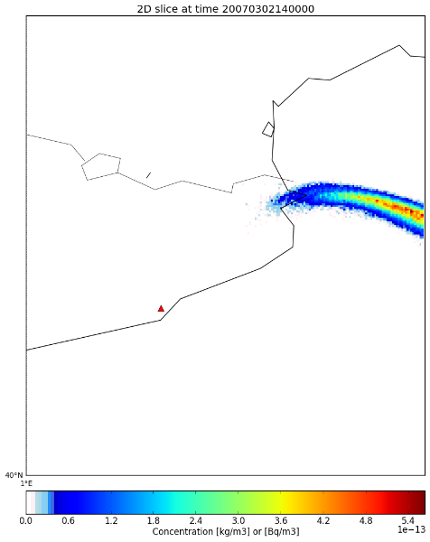
ECMWF: Hello World fwd & plotting
Results:
Did you get a ‘congratulations’ message on your run?
Yes → We should see the output produced
No → Were the option files well set? Was the compilation appropriate for your run? Is recompilation (with adjustment of par_mod.f90) needed?
./plot_FLEX_binary.py ./output_ECMWF/ False 1 0 0 alldates cyl False 0,20,37,44 mesh False
./plot_FLEX_binary.py ./output_ECMWF/ True 1 0 0 alldates cyl True 1.0,4.3,40.0,43.8 mesh False
Effect of number of particles…
10000 particles
1000000 particles
Notes:
10
10

Slide 11
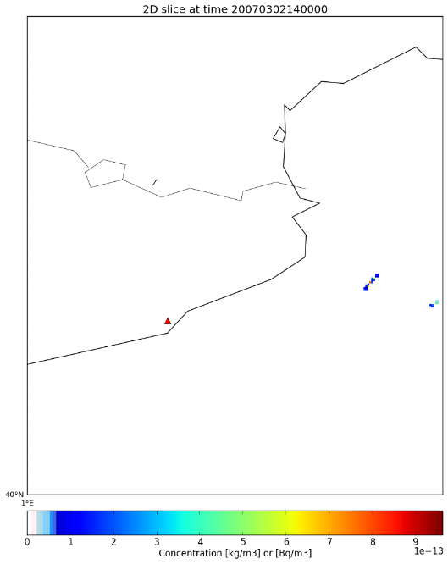
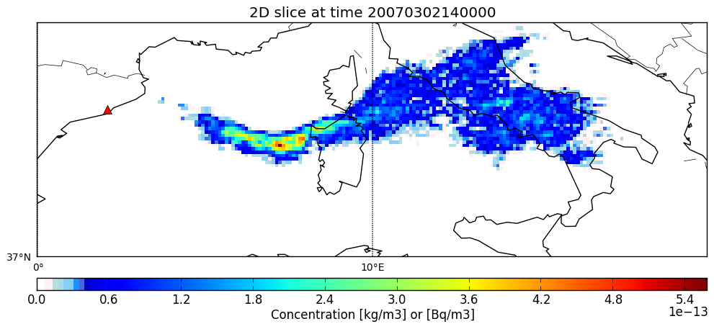
NCEP: Hello World fwd & plotting
Results:
Did you get a ‘congratulations’ message on your run?
Yes → we should see the output produced
No → where the option files well set? Was the compilation appropriate for your run? Is recompilation (with adjustment of par_mod.f90) needed?
./plot_FLEX_binary.py ./output_NCEP/ False 1 0 0 alldates cyl False 0,20,37,44 mesh False
./plot_FLEX_binary.py ./output_NCEP/ True 1 0 0 alldates cyl True 1.0,4.3,40.0,43.8 mesh False
10000 particles
Notes:
11
11

Slide 12
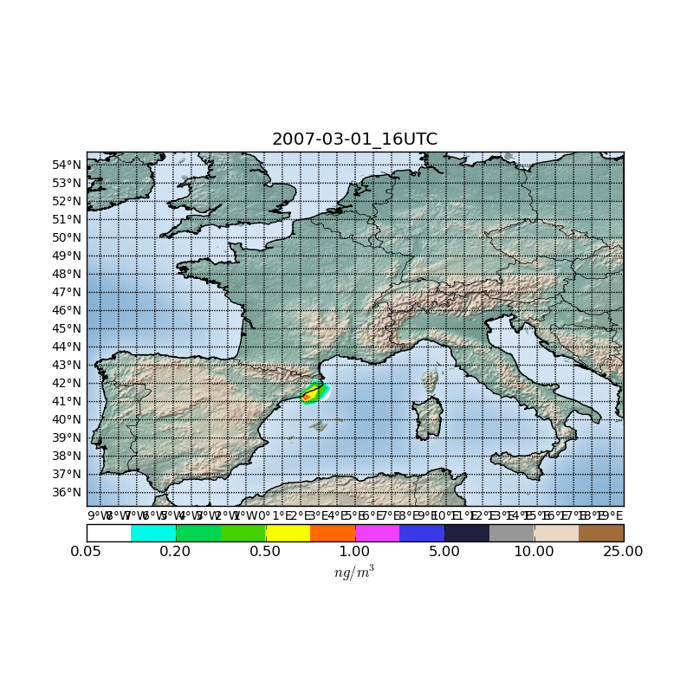
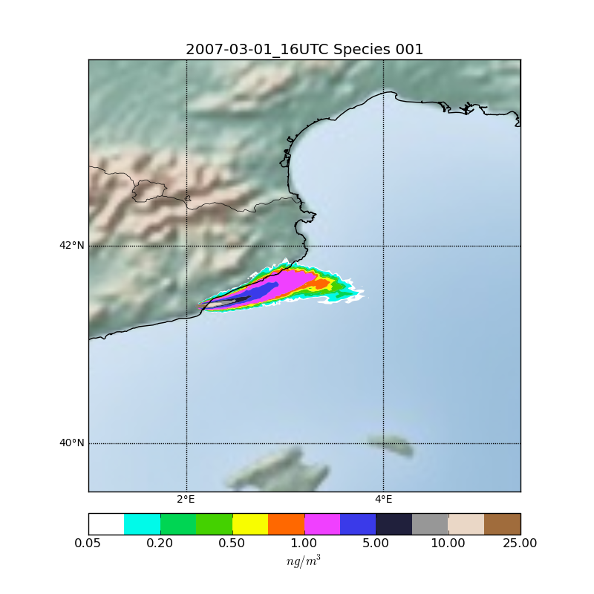
Hello World fwd & plotting
What can we see?
Results: plots of concentrations
Effect of OUTGRID resolution: Sharper and larger maxima, less smooth edges…
Notes:
12
12

Slide 13
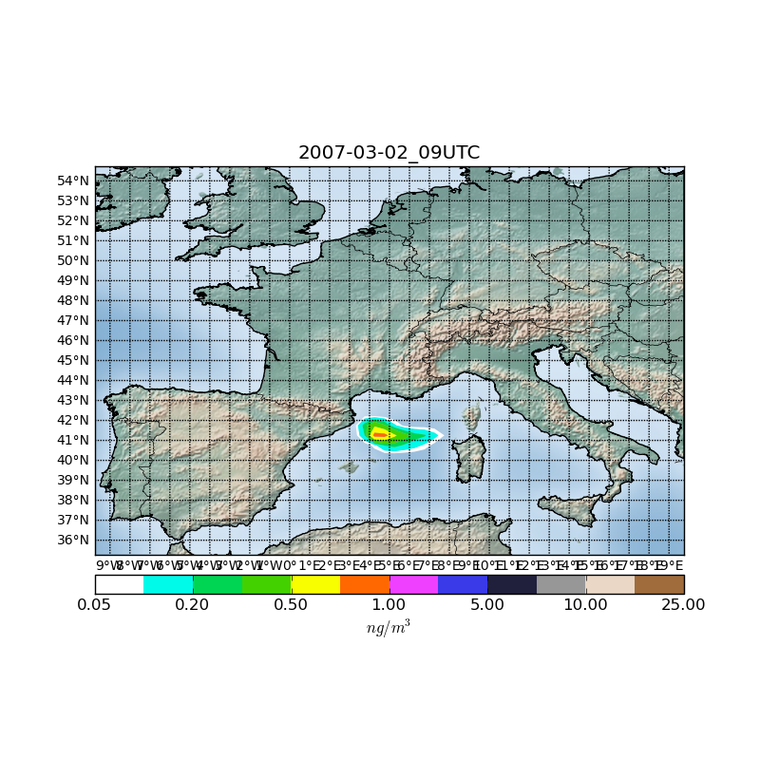
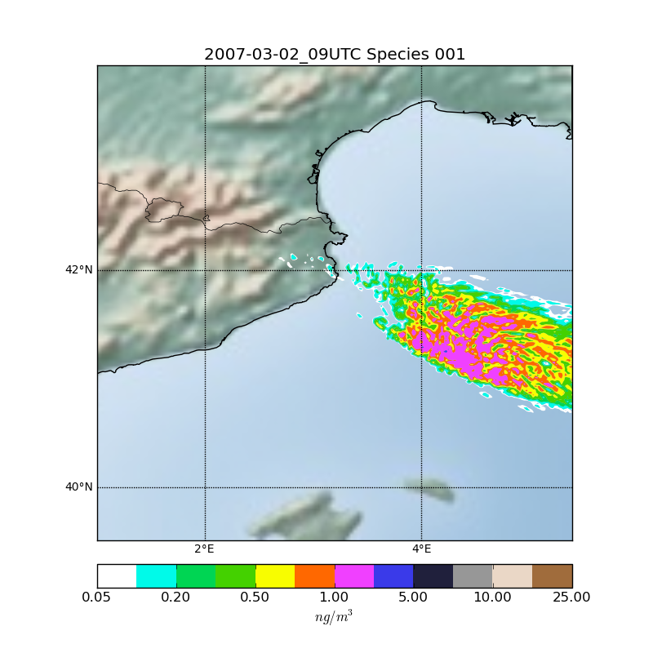
Hello World fwd & plotting
Results:
What can we see?
Effect of number of particles…
Notes:
13
13

Slide 14
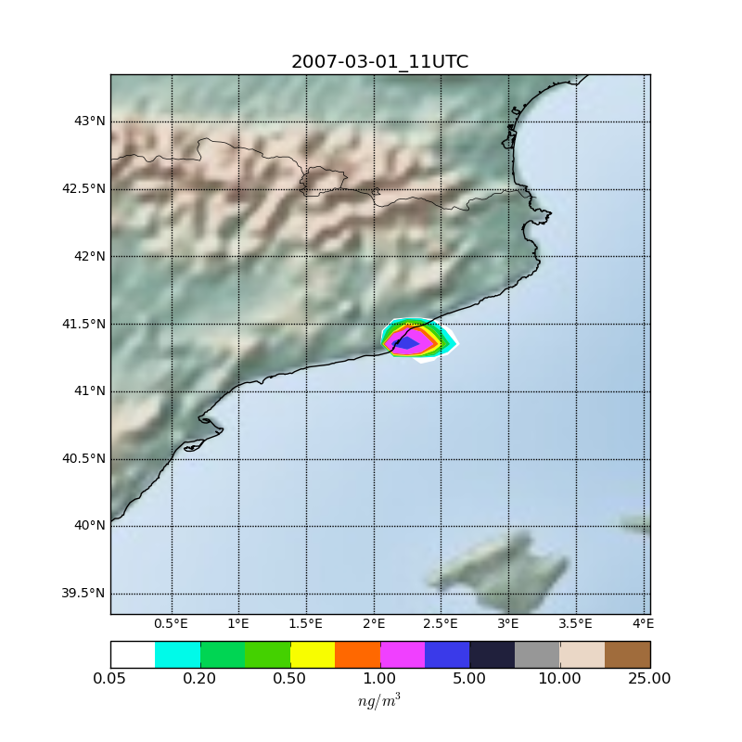
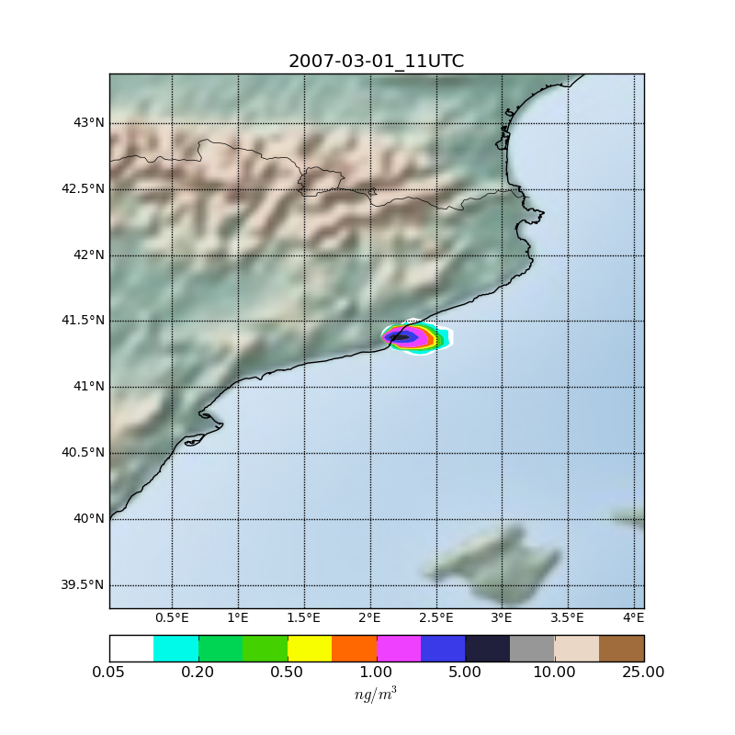
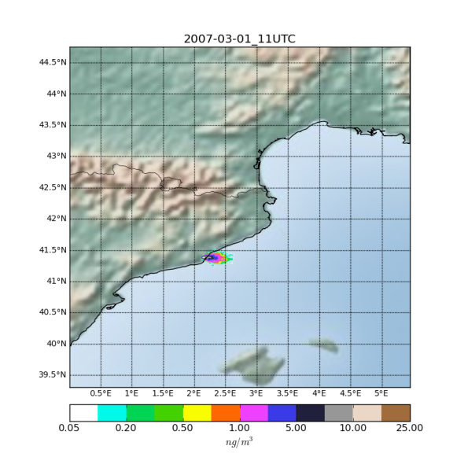
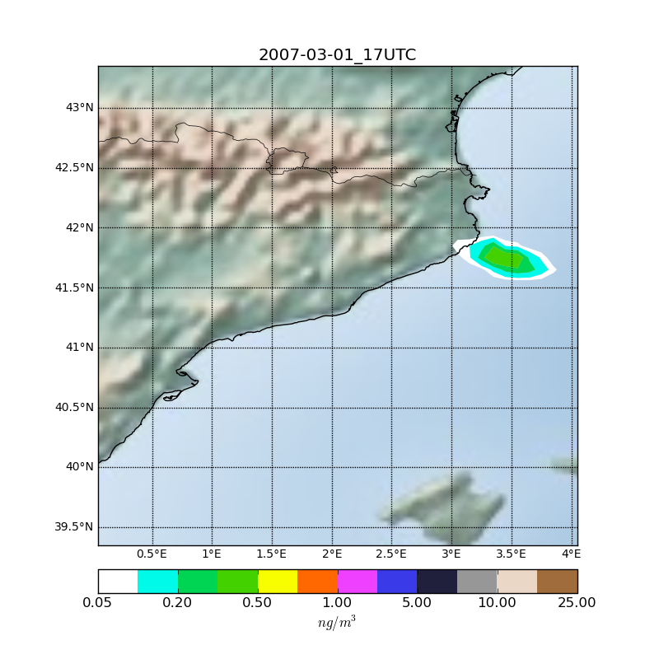
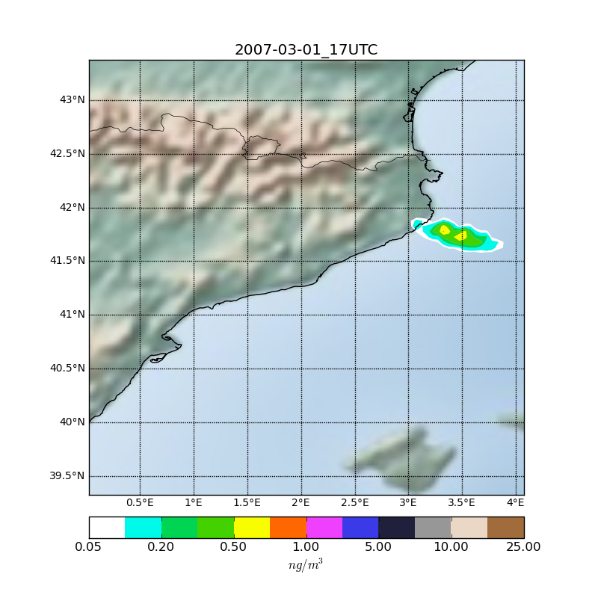
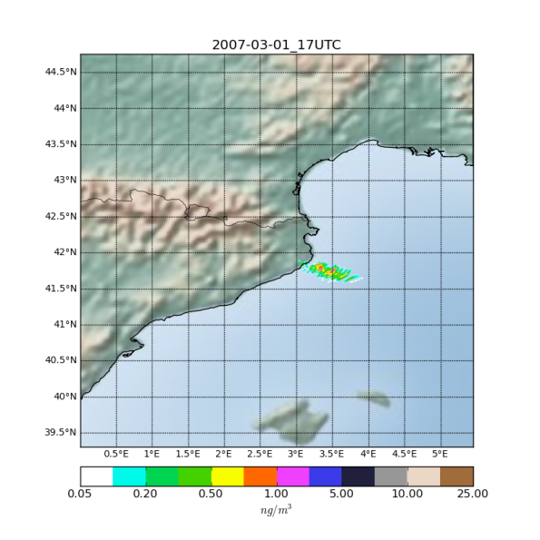
Hello World fwd & plotting
Another example: Output1 – 0.1 - 0.05 - 0.015
What does happen when resolution increases while keeping the number of particles ?

Slide 15
Hello World fwd & plotting
What to do?
Options:
Increase the number of particles → larger computational demands (FLEXPART 10 & FLEXPART-WRF are parallel/have option for a parallel executable) and the problem may appear later
Particle splitting → it increases the particles after a user-defined time-step. Number of particles increases exponentially and so do the computational times
Larger grid sizes (horizontal and vertical) so that more particles are sampled → smoothing
No perfect solution, trade-offs need to be made

Slide 16
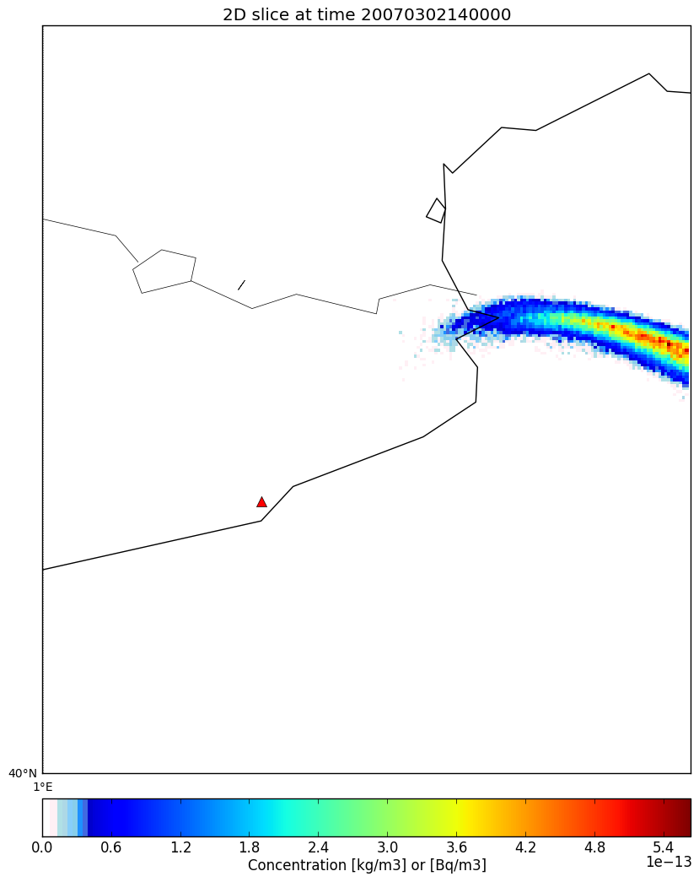
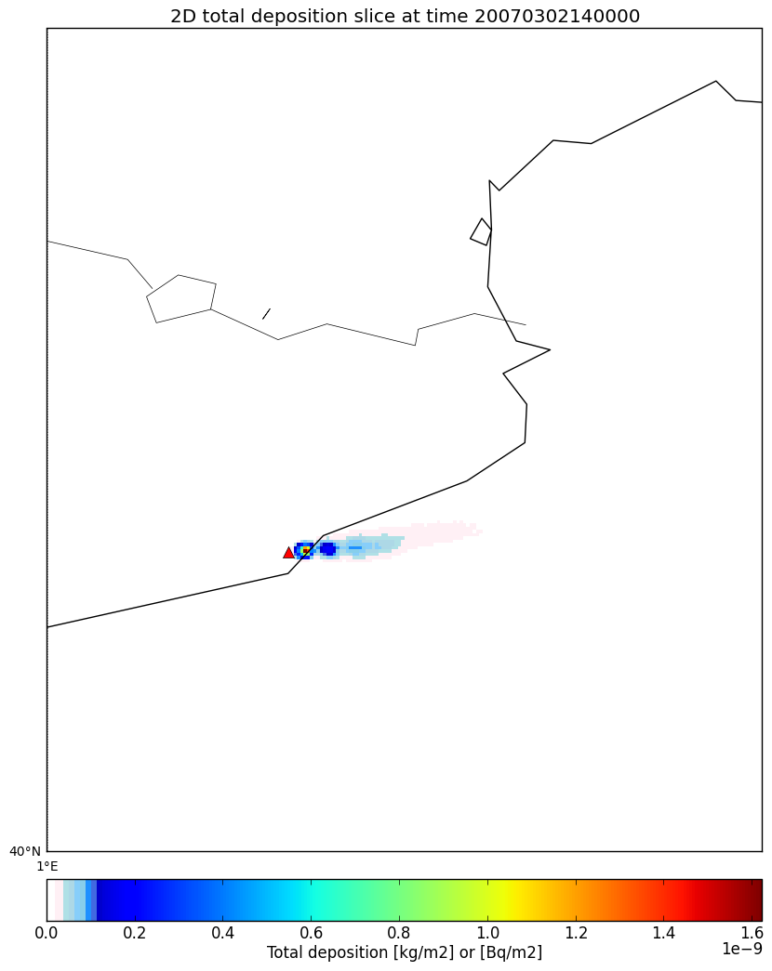
ECMWF: Hello World fwd & plotting
Results: Concentration and deposition
What can we see?
Notes:
16
16

